Slide 1
Phase 2 Tollgate Review Discussion Template
GSA, Unified Shared Services Management
Month, Year

Slide 2
Questions to be Answered
This template is intended to guide a Tollgate Review discussion between a Customer, USSM, and the Tollgate review team
Questions to Be Answered |  | Reviewers
 | Does the proposed solution offered by the provider meet standard requirements identified by the Service Area Managing Partner, including federal requirements, and USSM approved mission-specific requirements needed by the agency? | Service Area Managing Partner
 | Has there been sufficient market research conducted on providers? | Service Area Managing Partner; USSM
 | How inclusive is the risk analysis? Is the migration schedule realistic and achievable? Is the selected provider adequately resourced and prepared to support the new customer in the migration planning and migration phases? Is the customer adequately resourced and is the organization ready to begin the migration planning Phase? Are the scope of services and migration planning phase roles and responsibilities adequately defined and understood between customer and provider? Does the program have adequate plans to mitigate key risks and issues, and have contingency plans? | USSM
 | Has the LCCE been updated to reflect business requirements, and is it reasonable? | Resource Management Office (RMO) (C & Provider P); USSM; Office of the Federal Chief Information Officer (OFCIO)
 | Do the customer and provider efforts align with each office initiative? | M-Offices
2. Selection

Slide 3
Instructions for Completing This Template
This template is intended to guide a Tollgate Review Discussion between a Customer, USSM, and the Tollgate review team
To use this template:
Use the source documents included within each slide to develop summary-level information that will help guide the Tollgate review
Be prepared to discuss specific questions/content included on each slide before or during the Tollgate review
Once complete, send this template and required documentation to the USSM M3 team (USSM.M3@gsa.gov) to schedule a Tollgate review meeting
Direct any questions on content or information that should be included in this presentation to the USSM M3 team (USSM.M3@gsa.gov)

Slide 4
Documentation Required for Phase 2 Tollgate Review
The following documentation is required in guiding a discussion to demonstrate readiness and gain approval for Phase 2. Agencies purchasing transaction processing services only will identify relevant activities and artifacts for their project using the M3 Services Tailoring Guide.
Phase 2 Documentation
Provider Assessment Report (Federal Only) Engagement Phase Interagency Agreement (IAA) (Federal Only) Data Cleansing Plan Draft Request for Proposal (Commercial Only) M3 Risk Assessment Tool Business Needs Workbook Evaluation Criteria Draft Request for Information (RFI) and Responses (Commercial Only) Implementation Approach/Schedule Price Estimates for Engagement, Migration, and Operations and Maintenance (O&M) Business Process Reengineering Strategy Validated As-Is Process Maps | Life Cycle Cost Estimate (LCCE) for Engagement, Migration, and O&M Procurement Plan Initial Master Schedule HR/Staffing Plan Program Management Plan Independent Verification and Validation (IV&V) Plan Status Reports/Dashboards Risk Management Plan Risks, Actions, Issues, and Decisions (RAID) Log Labor Relations Strategy Change Management Plan Communications Plan Baseline Readiness Assessment Data Cleansing Scripts Decommission Plan
Information Contained in Tollgate Review Discussion
M3 Risk Assessment Tool Initial Master Schedule Overview LCCE Provider Selection Summary HR/Staffing Plan Update (Customer) HR/Staffing Plan Overview (Provider) Scope of Services (Overview) Business Needs Workbook Procurement Approach Change Management and Communication Approach Labor Relations Strategy Data Management/Data Quality Approach Draft RFI and Responses (Commercial Only) Top Risks Decommission Plan
Exit Criteria (to move into Phase 3)
Provider Selected (Federal Only) RFP Drafted (Commercial Only) Business Needs Workbook Mitigation Plans in Place for Major Risks/Issues Initial Master Schedule Updated | Staffing Plan Ready for Execution Data Cleansing Commenced LCCE Updated for Engagement, Migration, and O&M Communications to Stakeholder Delivered

Slide 5
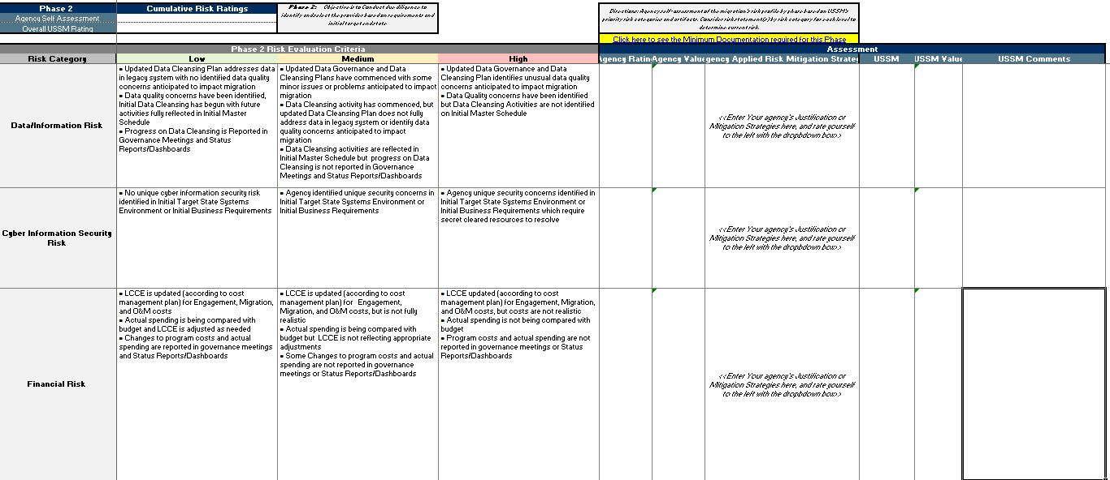
M3 Risk Assessment Tool
Determine the risk rating at the end of Phase 2 using the M3 Risk Assessment Tool and submit with tollgate review material.
ILLUSTRATIVE

Slide 6
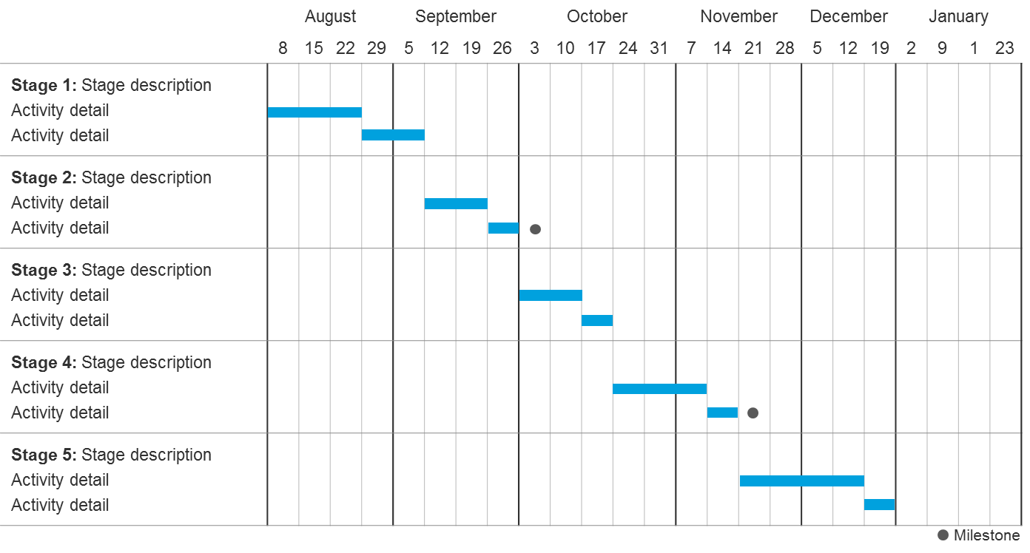
Initial Master Schedule Overview
Provide an overview of the Initial Master Schedule as of Phase 2
Provide an updated Master Schedule, which should include in addition:
Estimated migration schedule from Provider Selection (Federal Only)
Estimated RFP release and award timeline (Commercial Only)
**Provide information by month and year
ILLUSTRATIVE
Source Documentation from Playbook
Initial Master Schedule

Slide 7
Life Cycle Cost Estimate
Provide the estimated cost based on the LCCE*.
Develop the life cycle cost information for Phase 2 based on any changes or refinement in scope of the program from when the Major IT Business Case was developed
Estimated Costs for Migration and Operations and Maintenance (O&M)
Responsible Party (Provider, Agency, Other) | Migration Cost Category / Work stream | FY N CPM | FY N+1 CPM | FY N+2 CPM | FY N+3 CPM | Total CPM | Cost Calculation | Required FTEs | Notes/Assumptions
 | Program Management Support
 | Data Conversion Support
 | Change Mgmt./Train
 | Business Process Reengineering
 | Systems Engineering
 | <Project or Organization Determined>
 | Total Migration
Provider | <Service Layer 1>
Provider | <Service Layer 2>
Agency | <Agency Cost>
 | Total O&M
Grand Total
ILLUSTRATIVE
*To avoid duplication of effort, agencies are encouraged to use their existing budgetary documentation, when available, to provide cost estimates.
Source Documentation from Playbook
LCCE

Slide 8
Provider Selection Summary
Provide overview of how a provider was selected or will be selected based on decision to use a commercial or federal provider
Federal Provider
Commercial Provider
Describe the following:
The approach and results of your market assessment
Which Federal provider was selected, criteria used for selection, and the rationale for selecting the provider
Provide an overview of:
The approach and results of your market assessment
The justification for using a commercial provider
The scope of services you will be requesting within the Request for Proposal (RFP)
The timeline and plan for issuing the RFP
Source Documentation from Playbook
Provider Assessment Report

Slide 9
Human Resources/Staffing Plan Update (Customer)
Provide an Organization Chart and indicate required number of full time equivalents (FTEs)/resources, existing resource gaps, and plan to fill resource gaps
Consider including the following:
The roles and responsibilities needed for the customer migration team for Phase 3
Total number of resources needed and total number of resources staffed
The percentage of time required for each position on the customer migration team
Vacant positions and plan to fill each position
For each role, indicate if resources are in an acting, detailed, or contractor-filled position
Source Documentation from Playbook
Human Resources/Staffing Plan

Slide 10
Human Resources/Staffing Plan Overview (Provider)
Provide an Organization Chart and indicate required number of full time equivalents (FTEs)/resources, existing resource gaps, and plan to fill resource gaps
Consider including the following:
The roles and responsibilities needed for the provider migration team for Phase 3
Total number of resources needed and total number of resources staffed
The percentage of time required for each position on the provider migration team
Vacant positions and plan to fill each position
For each role, indicate if resources are in an acting, detailed, or contractor-filled position
Source Documentation from Playbook
Human Resources/Staffing Plan

Slide 11
Scope of Services Overview
Describe which services the organization desires for migration and Operations and Maintenance (O&M)
Migration
O&M
Describe required migration services (e.g., training, data conversion, systems integration) from the provider
Describe required O&M services, including:
Desired service (e.g., Financial Management, HR, Acquisition)
Function (e.g., Payable Management)
Description of services (i.e., transaction processing, business application support)
Source Documentation from Playbook
Business Needs Workbook Draft Request for Proposal (RFP) (Applies to Commercial Only)

Slide 12
Procurement Approach
Provide the details around planned procurements to support the migration
Potential data points could include:
Planned procurements for future phases, including provider Request for Proposals (RFPs) (if Commercial):
Planned Procurement (including Scope) | Acquisition Strategy | Status* | Planned Contract Value | Expected Award Date | Expected Period of Performance
Data Conversion: Provide services to extract and translate data from legacy application…
ILLUSTRATIVE
*Statuses may include: Early Planning, Requirements Defined, RFP Released, Award Complete
Source Documentation from Playbook
Procurement Plan

Slide 13
Change Management and Communications Approach
Describe the approach and strategy for change management, communications, and stakeholder management
Consider providing updates to the following:
The stakeholders that will be impacted by the migration
The change management activities that are planned for the program lifecycle with activity owners for the following:
Business Process Re-engineering
Communications
Training
Workforce Alignment
Source Documentation from Playbook
Communications Plan

Slide 14
Labor Relations Strategy
Describe the expected impact on labor relations
Consider including the following information:
What are the collective bargaining agreements that are impacted?
What is the plan to negotiate with unions?
Source Documentation from Playbook
Labor Relations Strategy

Slide 15
Data Management/Data Quality Approach
Provide an overview of the data management and quality approach including an overview of findings from the initial data assessment
Considering providing updates to the following:
The results of your data quality assessment
Data cleansing activities that have already begun
The timeline for future data cleansing activities
Success criteria used to measure data quality
Source Documentation from Playbook
Data Governance Model Data Cleansing Plan

Slide 16
Top Risks
Provide the top 5 – 10 risks identified to date and proposed mitigation strategies
Risk | Impact | Probability | Owner | Mitigation Strategy
<Risk 1: If adequate resources are not dedicated to data cleansing, then cleansing activities will be delayed and the quality of the conversion will be reduced> | High | Medium | Program Manager | <Dedicate additional resources to support data cleansing efforts no later than 5/5>
Source Documentation from Playbook
Risks, Actions, Issues, and Decisions (RAID) Log Risk Management Plan

Slide 17
Next Steps
Please describe the activities planned for the next 30, 60, and 90 days

